Slide 1
Printed Media

Slide 2
Signature Bindings

Slide 3
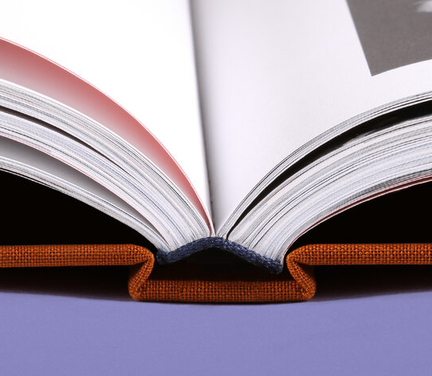
Case Bindings
Durable form of binding
Uses multiple signatures
Generally sewn, with added glue
Does not lay completely flat
BookArt, n.d.

Slide 4
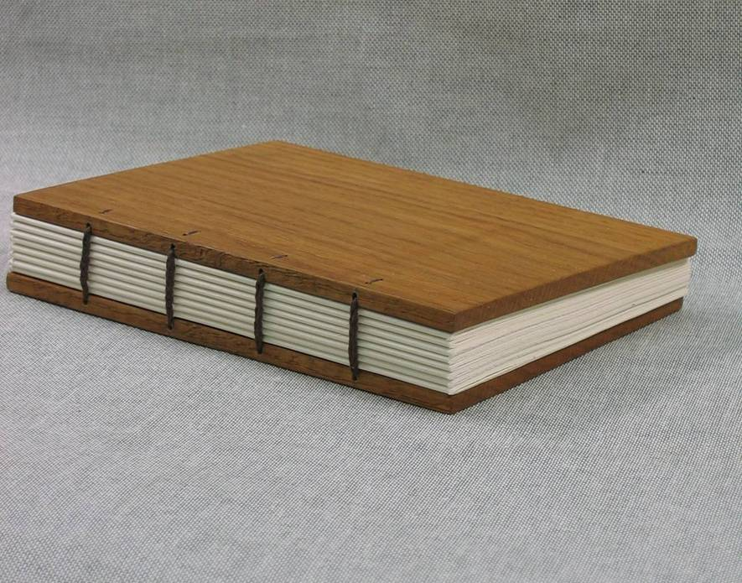
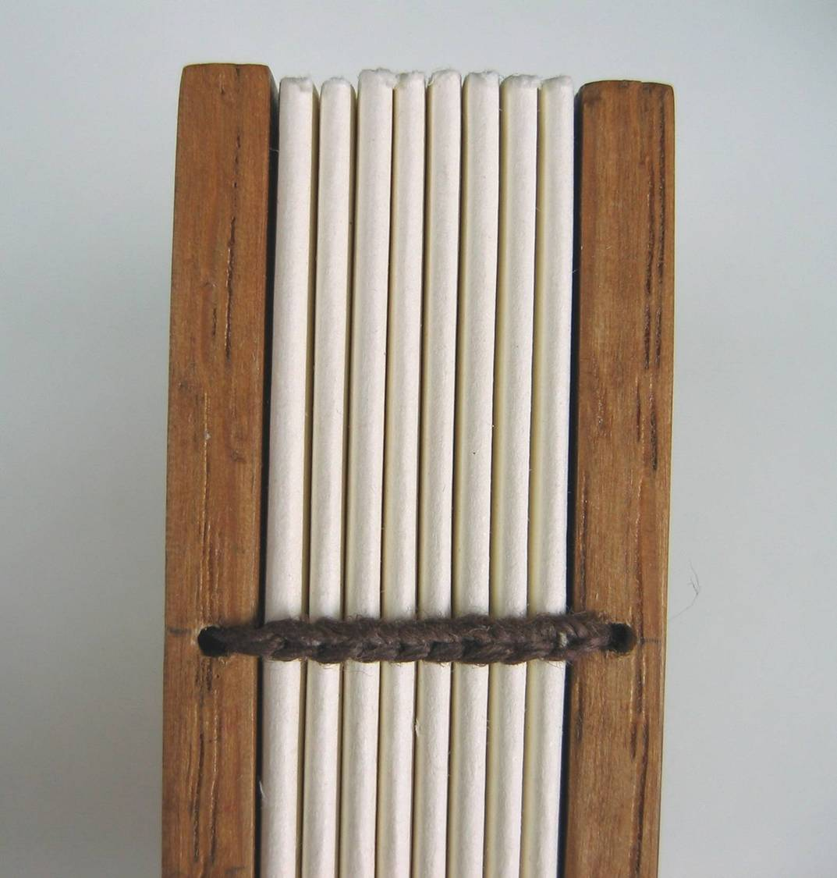
Coptic Bindings
Less durable form of binding
Labor intensive
One of the earliest methods used
Chained stitching
No spine required
Lays flat fairly easily
Ratbasket, 2007a, 2007b)

Slide 5
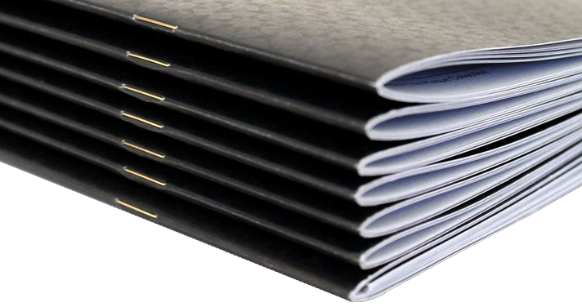
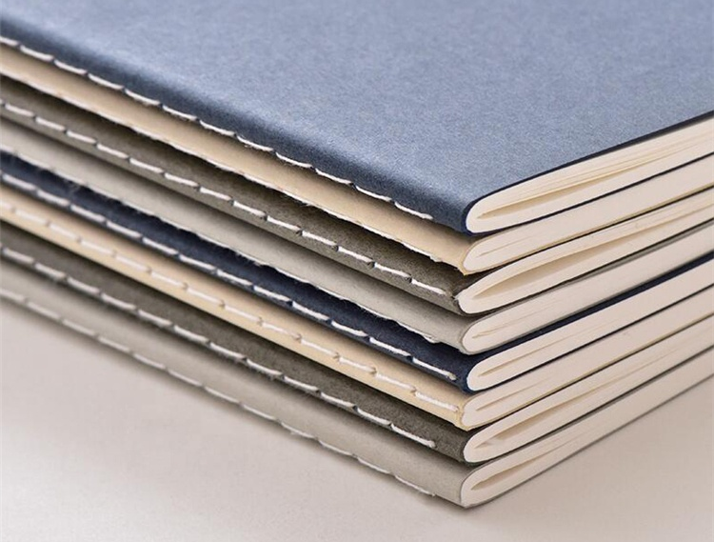
Saddle-stitch Bindings
Fast and low-cost form of binding
Not very durable
Only able to bind a single signature
Thread or staples used
No spine required
Generally does not lay flat
MBO America, n.d.; Scribble Tree, n.d.

Slide 6
Edge Bindings

Slide 7
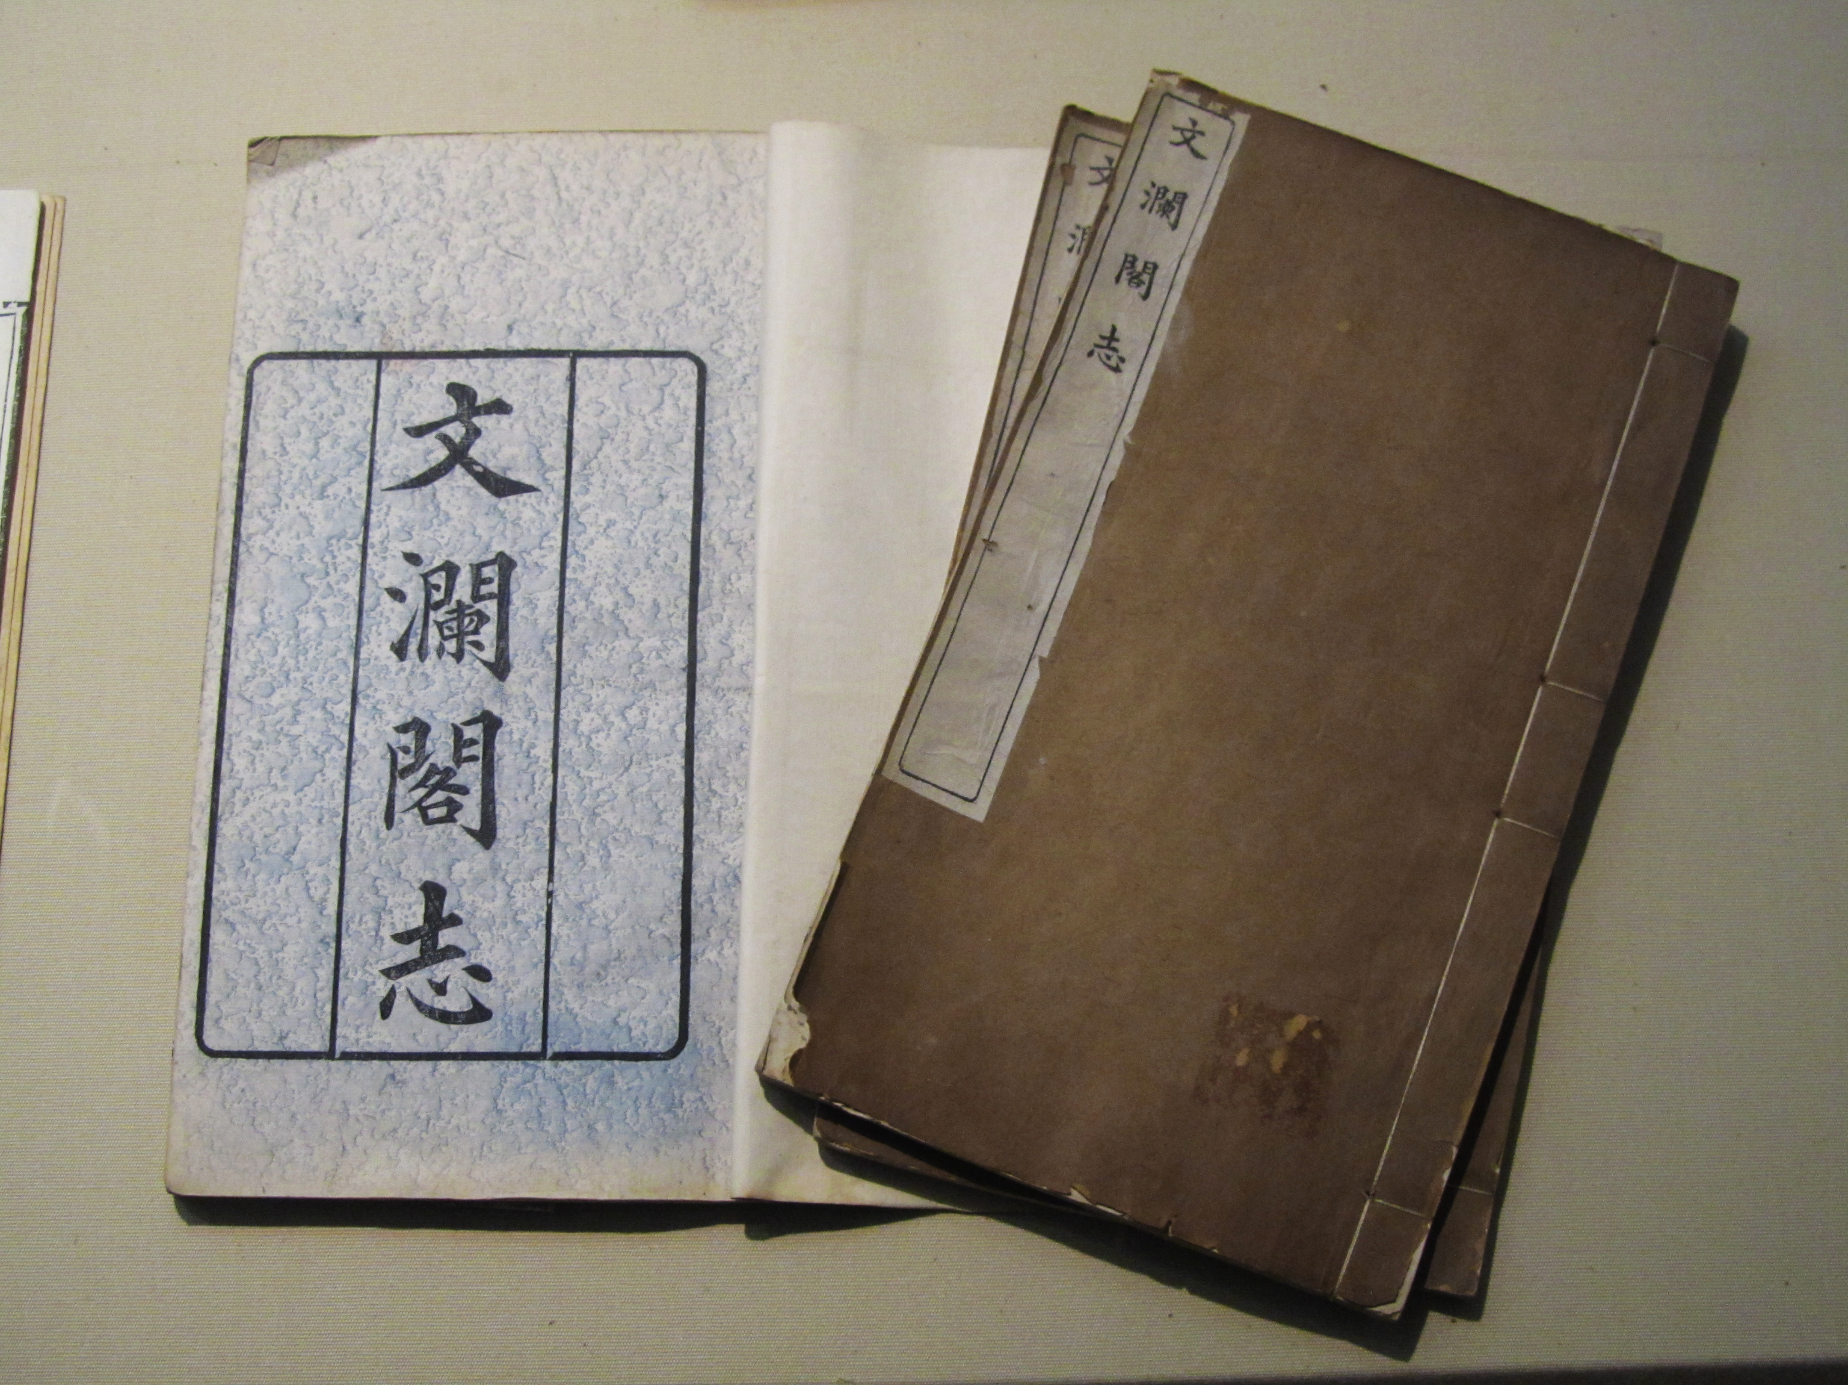
Stab Bindings
Traditionally used in many parts of East Asia
Pages sewn through the face in a single block
No spine required
Requires large margins on the bound edge
Does not lay flat
猫猫的日记本, 2014

Slide 8
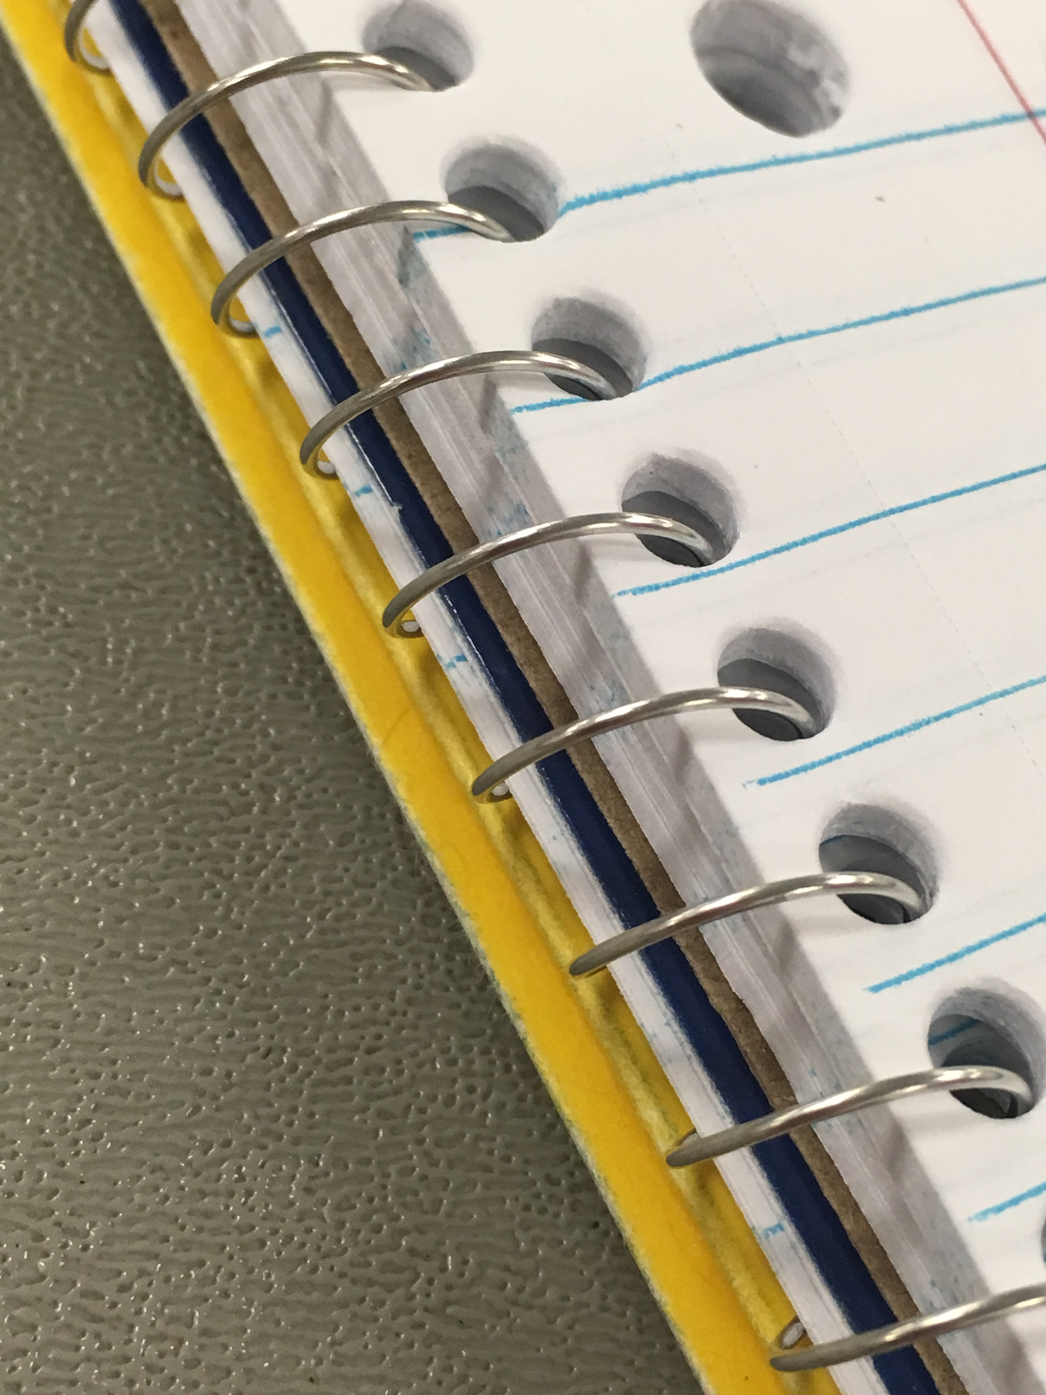
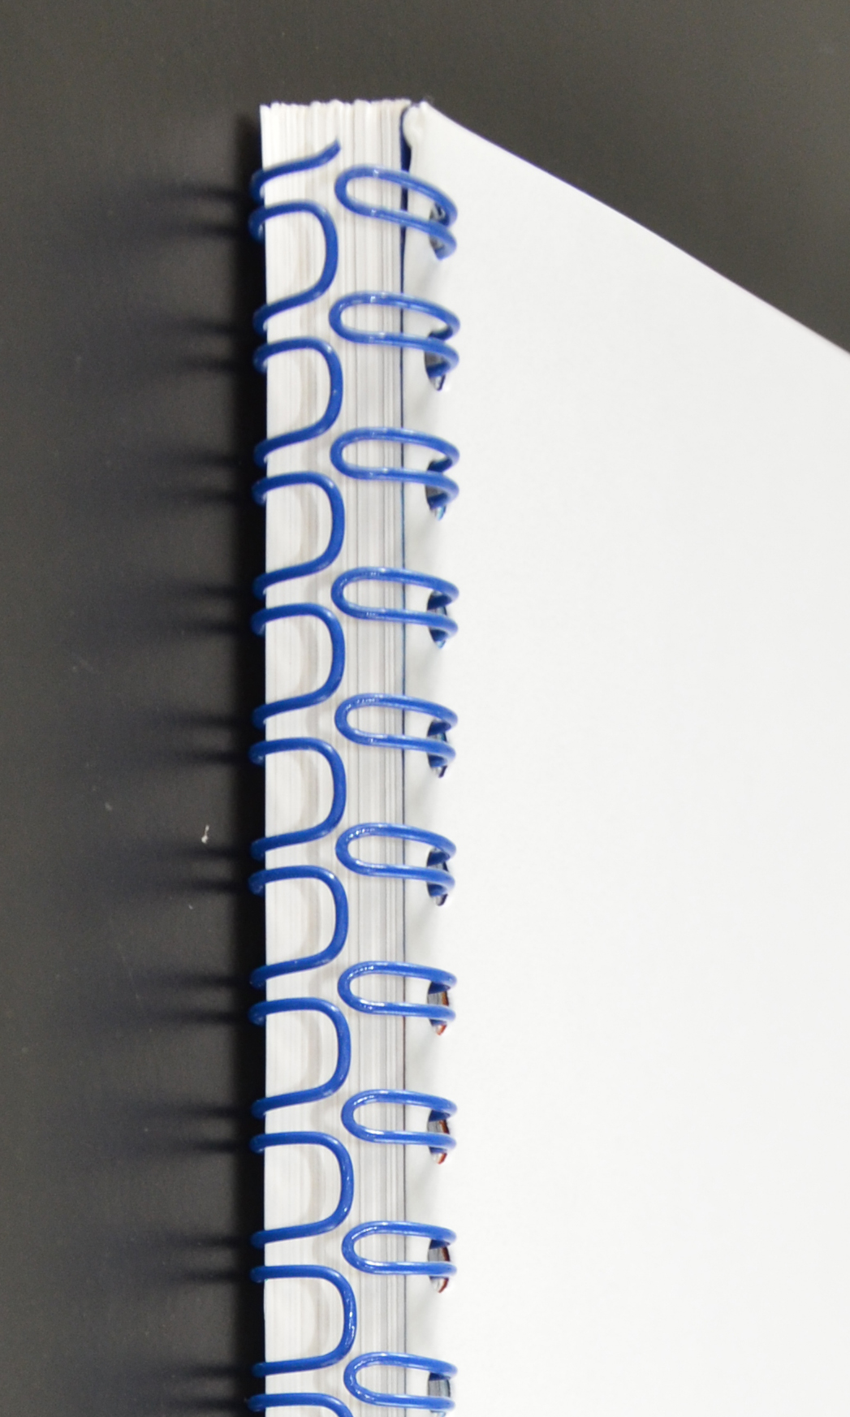
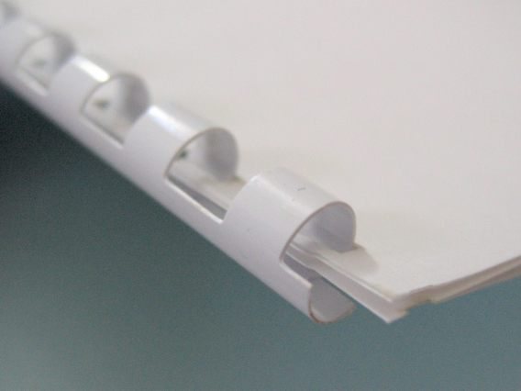
Wire/Spiral/Comb Bindings
Fast and low cost
Not durable
Works equally well with missing pages
Lays completely flat, and wire-bound (ex. spiral notebooks) can opened to 360 degrees
Jenniferjanette1, 2016;
Digitalgadget, 2008;
Monster4711, 2011

Slide 9
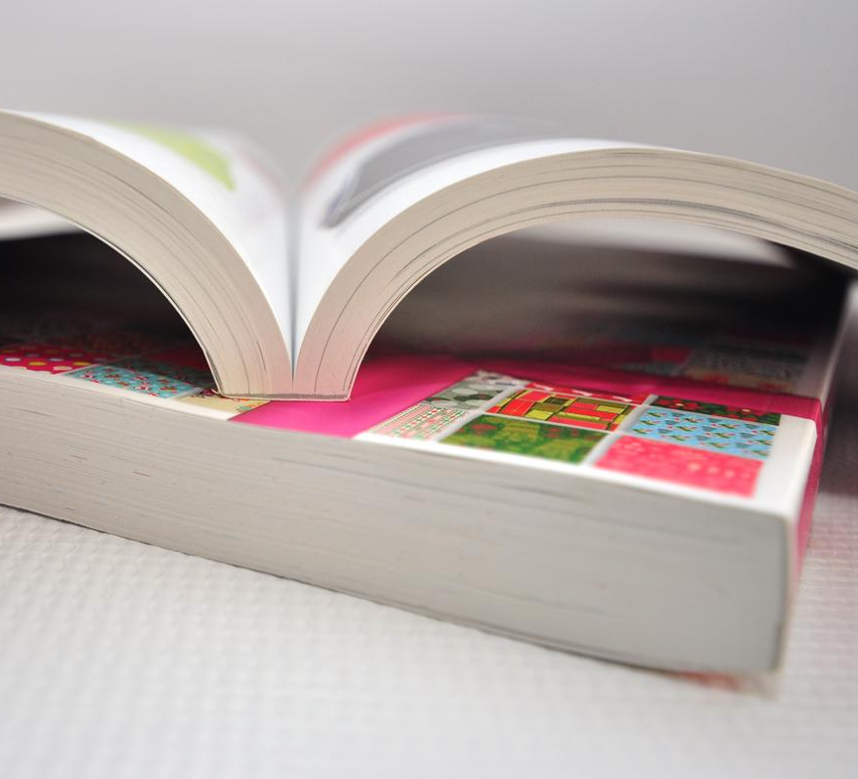
Perfect Bindings
Low cost and relatively durable
Secures edges of pages to the spine with glue
Relatively new binding method
Does not lay flat, and spine can be damaged from this
Casey Printing, n.d.

Slide 10
References
BookArt. (n.d.) Case binding – section sewn [Photograph]. BookArt. https://www.bookart.ca/binding-materials-finishing
Casey Printing (n.d.) Perfect bound books [Photograph]. Casey Printing. https://www.caseyprinting.com/blog/2014/print/binding-which-one-is-right-for-your-print-job
Digitalgadget. (2008, December 4). Step 4 of comb binding – the completed binding [Photograph]. Wikimedia Commons. https://commons.wikimedia.org/wiki/File:Comb_bind_step4.JPG
Jenniferjanette1. (2016, September 19). Notebook and folder on a table [Photograph]. Wikimedia Commons. https://commons.wikimedia.org/wiki/File:Notebook.jpg
MBO America. (n.d.) Saddle stitched notebooks with staples [Photograph]. MBO Komori Group. http://www.mboamerica.com/solution/web-fed-digital-saddle-stitching/
Monster4711. (2011, October 12). Wire-O [Photograph]. Wikimedia Commons. https://commons.wikimedia.org/wiki/File:Wire-o.jpg
Ratbasket. (2007, July 25 a). Detail of sewing on a model Coptic binding created by Ratbasket in 2003 [Photograph]. Wikipedia. https://en.wikipedia.org/wiki/File:Coptic_sewing.jpg
Ratbasket. (2007, July 25 b). Model Coptic binding created in 2003 by Ratbasket [Photograph]. Wikimedia Commons. https://commons.wikimedia.org/wiki/File:Coptic_flat.jpg
Scribble Tree. (n.d.) Saddle stitched notebooks with thread [Photograph]. Scribble Tree. https://www.customnotebook.com/product-item/wholesale-composition-books/
猫猫的日记本. (2014, April 12). Records of Wenlan pavilion, 2014-04 [Photograph]. Wikimedia Commons. https://commons.wikimedia.org/wiki/File:Records_of_Wenlan_Pavilion_2014-04.JPG

